Slide 1

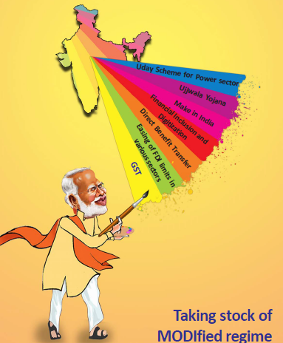

Slide 2
Macroeconomic stability defining feature of first three years of NDA regime
The defining feature of the Indian economy over May 2014 - May 2017 has been the achievement of macroeconomic stability. Taming of inflation (supported by benign crude oil prices) coupled with controlled twin deficits – both fiscal as well as current account deficits – and stable currency are the key achievements of the past three years.
This has provided a resilient backdrop for foreign capital inflows to the Indian economy (reflected in the highest-ever FDI inflows). The stable macroeconomic backdrop augurs well from the “growth-inflation” perspective.

Slide 3
Macro Economic Data Stability – Biggest Achievement

Slide 4
Benefits from stable macros
Softer Crude prices & subdued vegetable prices have allowed RBI to pursue rate cuts
Fiscal Deficit has improved from 4.1% in 2014 to 3.9% in 2016 & expected to be at 3.6% in 2017
Strong currency with stability has boosted foreign inflows. Over all in FY 17, India attract $ 36 bn of FDI and another $ 7.1 bn of FII inflows – Highest inflow since liberalization

Slide 5
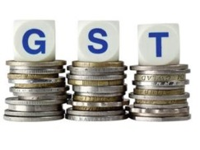

Flood of Reforms
Some signature Initiatives by the Government
GST (1st July 2017)
DBT (Subsidy Reforms)
Easing of FDI limits in various sectors
Financial Inclusion and Digitisation
Make in India
Ujwala Yogna and Uday Scheme for Power Sector
Demonetization
The common thread running across reforms like GST and Demonetization seems to be a thrust towards formalization of the economy and enhancement of tax base. Demonetization has also resulted in a deluge of liquidity in the system, driving interest rates lower

Slide 6
Flood of Reforms
10 year G-sec yields fell sharply post demonetization
Liquidity surplus has expanded after demonetization
Demonetization has accelerated the Digital transactions in BFSI
No. of POS terminals has shown sharp jump post demonetization
Source: MOSL, RBI
Source: MOSL, RBI

Slide 7
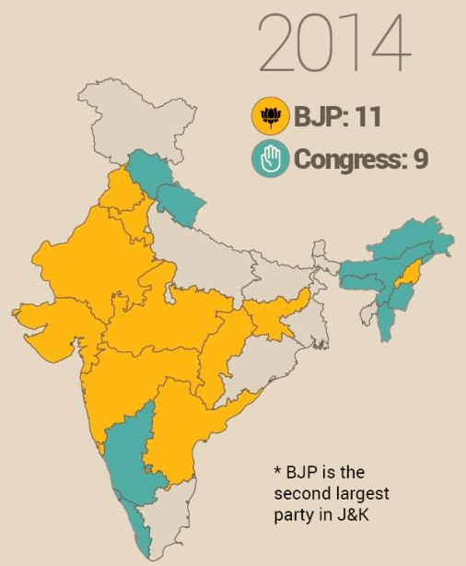
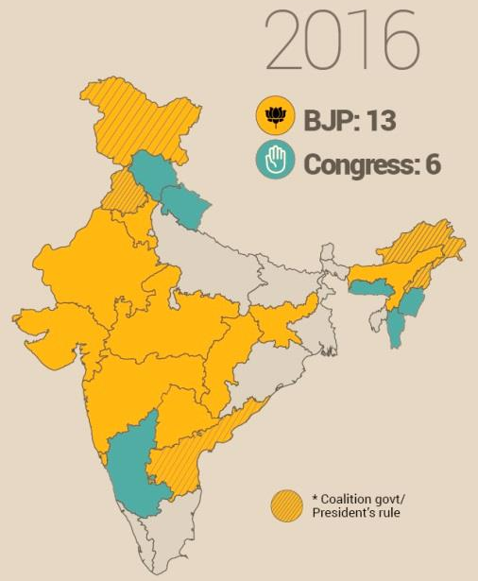
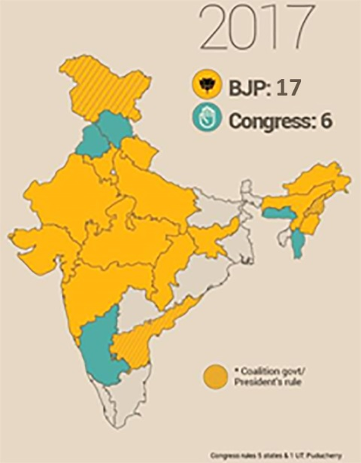
BJP expanding footprints

Slide 8
NIFTY Journey in last 3 years

Slide 9
Markets at all-time highs, but earnings flat for last three years
The Nifty has appreciated at a CAGR of 9.8% and the CNX Midcap has delivered 24.8% CAGR over May 2014 - May 2017.
Over May 2014 - May 2017, cumulative institutional inflows stood at USD41.1b (FII – USD24.9b, DII – USD16.2b). But over the last 24 months, domestic institutional flows have picked up significantly and outpaced foreign institutional flows (DII inflows at USD16.9b v/s FII inflows of USD6.8b).
The consistent DII inflows have broadened the valuation premium of midcaps over large-caps. The one-year forward P/E stands at 18.6 for the Nifty v/s 19.4 for the CNX Midcap 100.

Slide 10
Earnings to revive after TEPID three years
The Nifty’s earnings performance has been flat, with EPS fluctuating at around INR400 over FY14-17
Lack of private CAPEX revival
Asset Quality review of Banks
Deflation in commodity prices
Two consecutive years of drought
Demonetization

Slide 11
Earnings growth over the last three years has been lackluster, with flattish Nifty EPS over FY14-17.
Earnings growth was hamstrung by the absence of revival in private investment cycle, two consecutive droughts (impacted consumption spending), asset quality stress at public sector (PSU) banks and corporate private sector banks, deceleration in credit growth, deflation in commodity prices in FY16 and the demonetization exercise.
While we are disappointed by the lack of earnings growth, we believe the underlying change in the economy has erased the problems of the past and created a foundation for future growth.
Earnings growth would be driven by low base and recovery in earnings of cyclicals (Metals, PSU Banks, Autos). Also, government spending in rural areas and normal monsoons could boost consumption in FY18.

Slide 12
Earnings – Change of Sector Composition
(PAT14-17 CAGR %) - Cement, Media, Oil & Gas have grown the fastest, whereas PSU Banks & Metals have witnessed de-growth
Source: MOSL
Though Nifty earnings have remained flat over the last three years, the earnings composition has changed drastically. Cement, Media, Oil & Gas, and Consumer sectors have grown the fastest; Metals and PSU Banks have been the key laggards.

Slide 13
Sector Performance – since 2014

Slide 14
  Future Themes

Slide 15
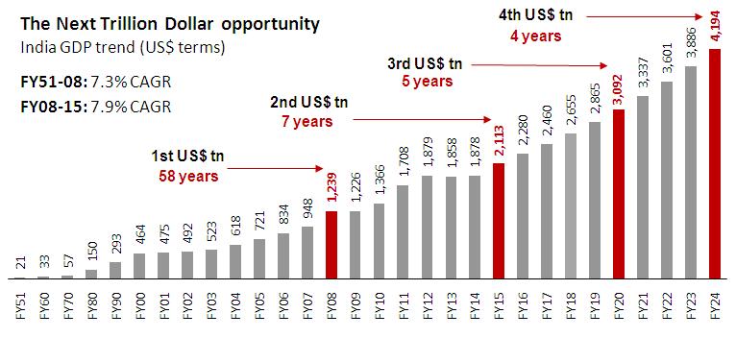
Discretionary - Consumption
India’s NTD (Next Trillion Dollar GDP)
Linear growth …
Every successive NTD of GDP takes fewer years

Slide 16
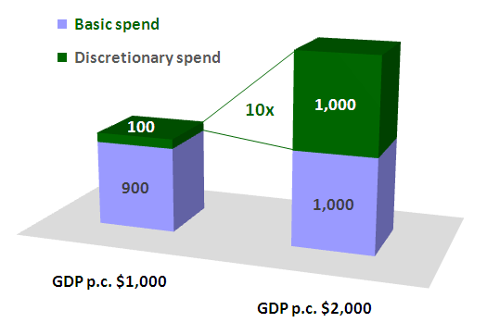
India’s NTD (Next Trillion Dollar GDP)
… Exponential opportunity
When per capita GDP doubles, discretionary spend becomes 10x

Slide 17
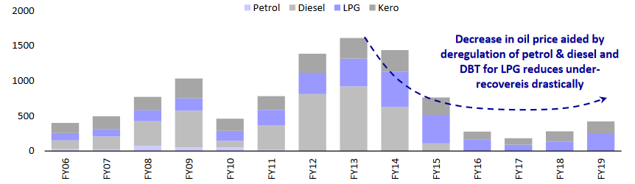
Oil & Gas: Continued deregulation; boost to city gas distribution
One of the important achievements of government in the last three years has been the resurrection in the fortunes of a very critical sector i.e. Oil & Gas Sector
Continued deregulation of fuel prices has improved the fortunes of Oil Marketing Companies (OMC’s) and has paved the way for zero subsidy
Petrol being deregulated 2010 itself, the NDA government deregulated diesel in 2014.
Government aims to decrease the import for Oil & Gas and has introduced certain policy:-
  Allowing exploration in already developed areas
  Lesser regulatory approvals
  Revenue sharing model for discovered marginal fields
  Creation of a national data repository etc.
Introduction of DBT schemes for LPG eliminating the leakage of subsidy, deregulation of Diesel and introduction of certain policies as described above all has helped in the resurrection of the Oil & Gas sector
Gross under-recoveries have come off substantially
Source: MOSL, Company

Slide 18
Affordable Housing: Potential Impact on the economy
Sustainable economic growth, urbanization and rapid change in socio-economic profile will drive demand for affordable housing segment.
Rising disposal income - Per capita income is expected to increase from 2,800 USD in 2012 to 8,300 USD by 2028
Increased focus from Government with “Housing for all by 2022” vision of the current Government
Increase in urbanization: About 10 million per annum people moving to urban cities .Urban cities are expected to contribute 70 to 75% of the GDP by 2020
Home ownership culture among Indians has encouraged them to own a house across any income groups
High Demand supply gap for residential units priced below 10 Lacs
Demand supply dynamics of housing for various income
Cost of Units (INR 000)
Share of Demand/Supply(%)
Amount in (000)

Slide 19
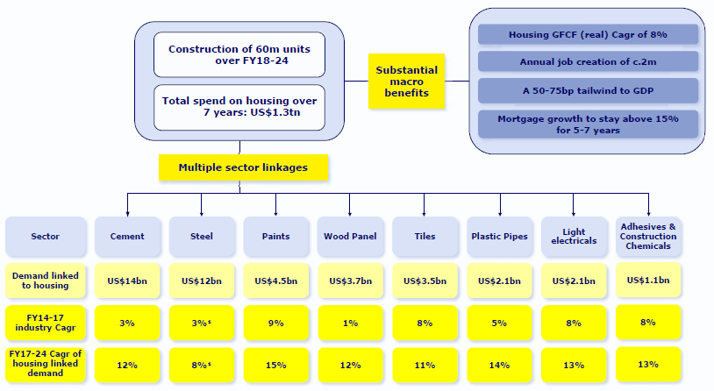
Affordable Housing: Potential Impact on the economy
Growth in Affordable Housing to create parallel demand for sectors

Slide 20
GST : Movement from unorganised to organised sector
GST regime from 1st July 2017 - removal of cascading effect; seamless tax credit & facilitating ease of doing business would be the core benefits arising out of the implementation – which will benefit the large organized companies across segments
The advent of GST will force large parts of the economy to migrate from black to white, leading to a 4.2% growth in real GDP as per federal bank.
Entry into the formal economy will allow firms to avail affordable working-capital finance from banks and NBFCs rather than relying on moneylenders. Such financing will shorten working-capital cycles and boost ROCEs of the listed companies.
Large companies in the organized sector have to run fragmented operations due to the prevalence of state-specific tax regimes. GST will integrate such pan-India operations..
Thus, companies which are operating in sectors with high organized component will benefit in terms of increased demand. Companies in sectors like paints, appliances, apparel, plastic pipes, ceramic tiles, batteries, etc. will stand to benefit
Market share gain won’t be in immediate future, it will take few years for this transition to happen, as organized players will keep gaining market share and unorganized will become uncompetitive due to full tax.

Slide 21
GST : Movement from unorganised to organised
GST Impact on Sectors….. !!!
Sector | Unorganized to organized | Availability of Input Tax Credit | Change in Tax Rate | Supply Chain Management | Overall
Auto-Batteries
Logistics
Auto- Two/Four Wheeler
Cement
Highly Positive
Positive
Slightly Positive
Neutral
Sector | Unorganized Segment (%)
Apparels Industry | 70%
Ceramic | 50%
Batteries | 40%
Paints | 35%
Pumps | 30%
Unorganized Economy in Sectors……!!!

Slide 22
Value Migration : From PSU to Private Banks
At present, PSU banks have ~70% market share Vs 30% with private banks due to the value migration few years down the lane their market share will be equal.
Banking sector is the back bone of any economy because it is the primary source of credit for the businesses
The total stressed assets in public sector banks are close to 10 lac crores, and this includes NPAs plus a system wide stress. The same is causing dent on PSB’s lending ability as they are also strained on capital.
Economy has to grow at 6.5 – 7%, the burden of credit growth has to be taken by the Private Sector banks as PSU are struggling with Non Performing loans and stretched capital adequacy
Private banks contributed 13.4% of Nifty PAT in FY17, as compared to PSU banks with 2.9% in FY17
Nifty PAT contributors – Comparison of PSU banks & Private Banks

Slide 23
Value Migration : From PSU to Private Banks
GNPA have been on growth trajectory in the PSU banks compared to private banks
In (00) Crores
Loan Growth Trends: Private Banks outpacing the Public Banks

Slide 24
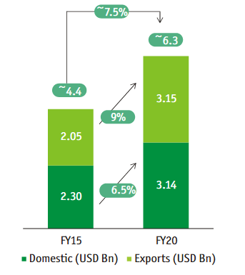
Farming Industry: Starting of a New Revolution
PM Modi wants to double the farm income by 2022, to bridge the inequality in income between the urban and rural population
According to Department of industrial Policy and Promotion, the agricultural sector has attracted a FDI equity inflow of about US$ 2,315.33 million from April 2000 to December 2016. This momentum of investment is expected to get better
According to report of Tata Strategic Management Group (TSMG), Indian agrochemical industry which is estimated at $ 4.4 billion in FY15, is expected to grow at 7.5 percent annually to reach $ 6.3 billion by FY20
Automobile sector is likely to benefit, according to the report by CRISIL Research, domestic tractor sales are expected to close fiscal 2017 with impressive 16%-18% growth
Agrochemical Market Growth driven by government reforms

Slide 25
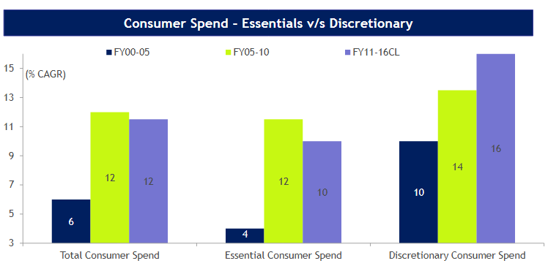
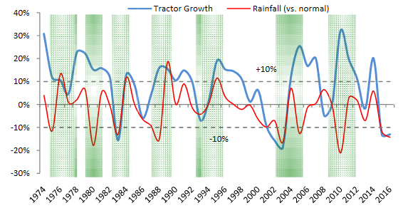
Farming Industry: Starting of a New Revolution
Increasing Consumer Discretionary spends driven by growing rural income
Agri Automobile growth depends on good monsoon & government reforms

Slide 26
Thank You

